Slide 1
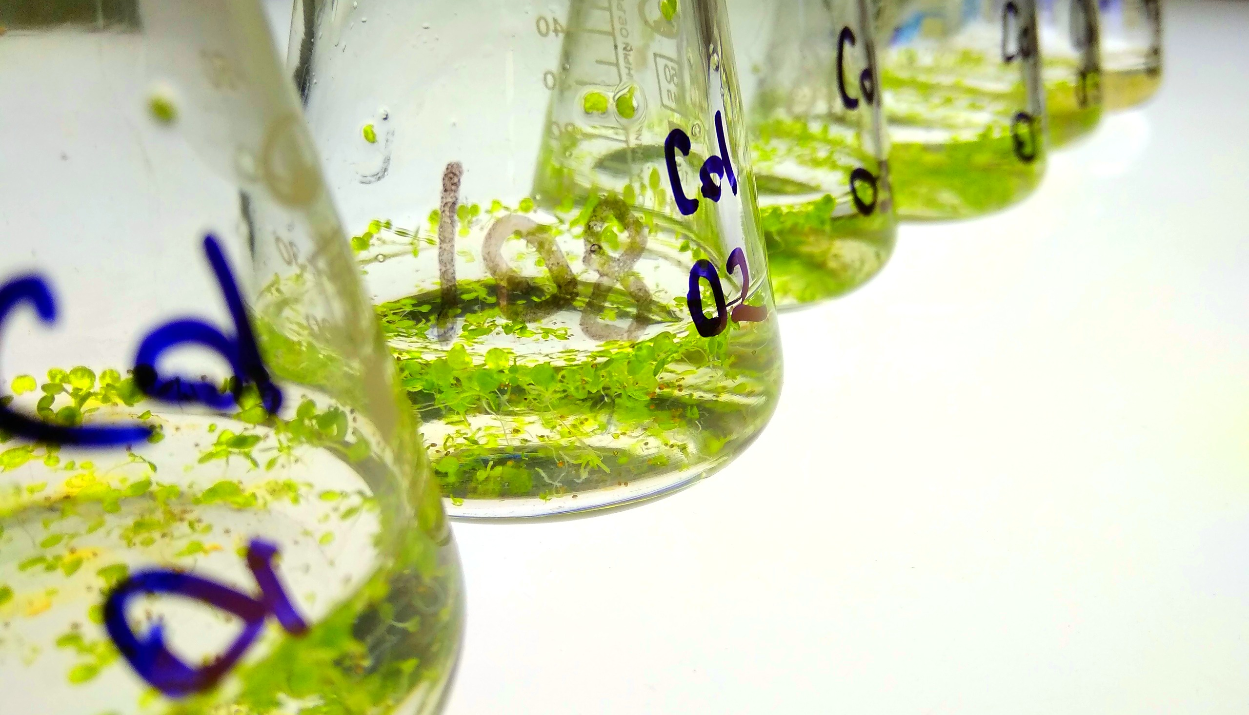
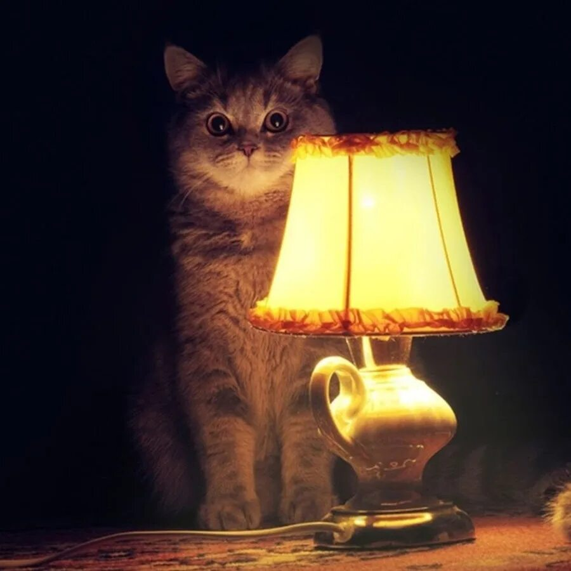
Gene expression, qPCR and so on
Jun.res. of SIPPB SB RAS
Plan genetic engineering lab.
I.V.Gorbenko

Slide 2
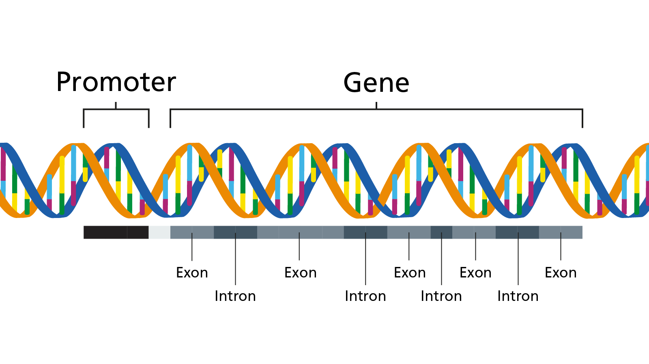
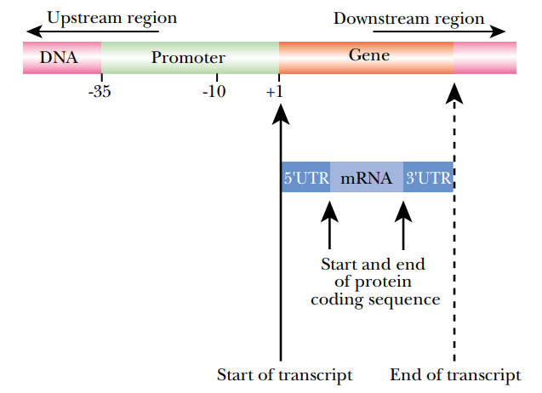
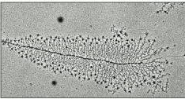
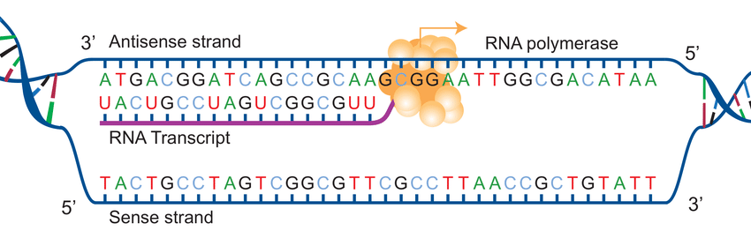
What is a gene?
cDNA
CDS
(Miller and Beatty, 1969)

Slide 3
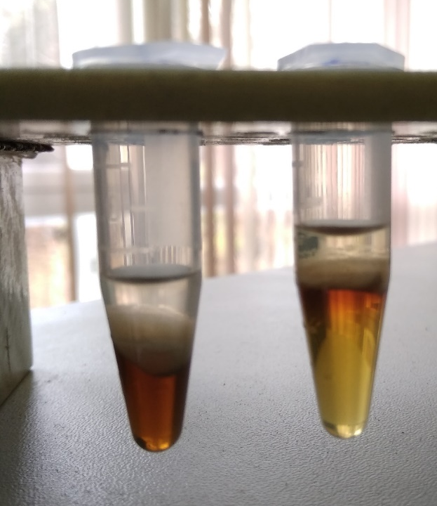
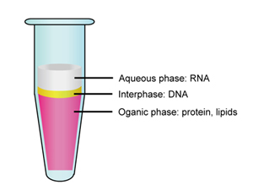
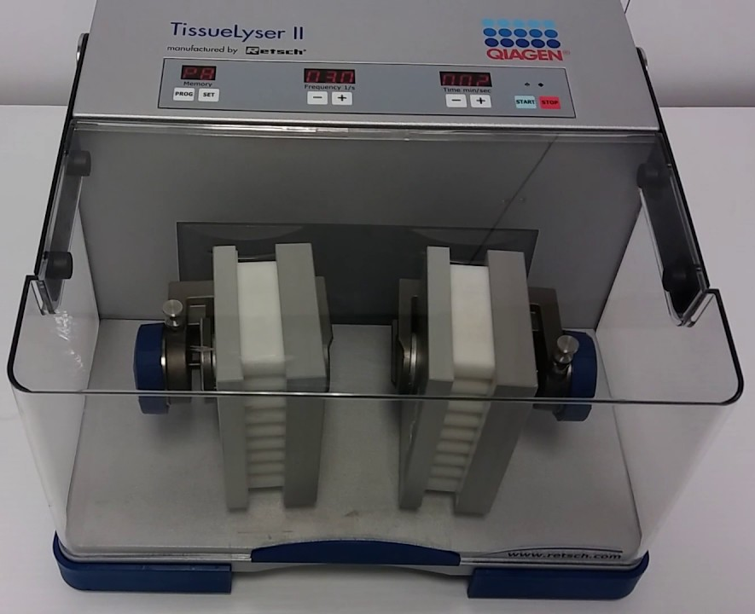
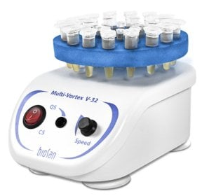
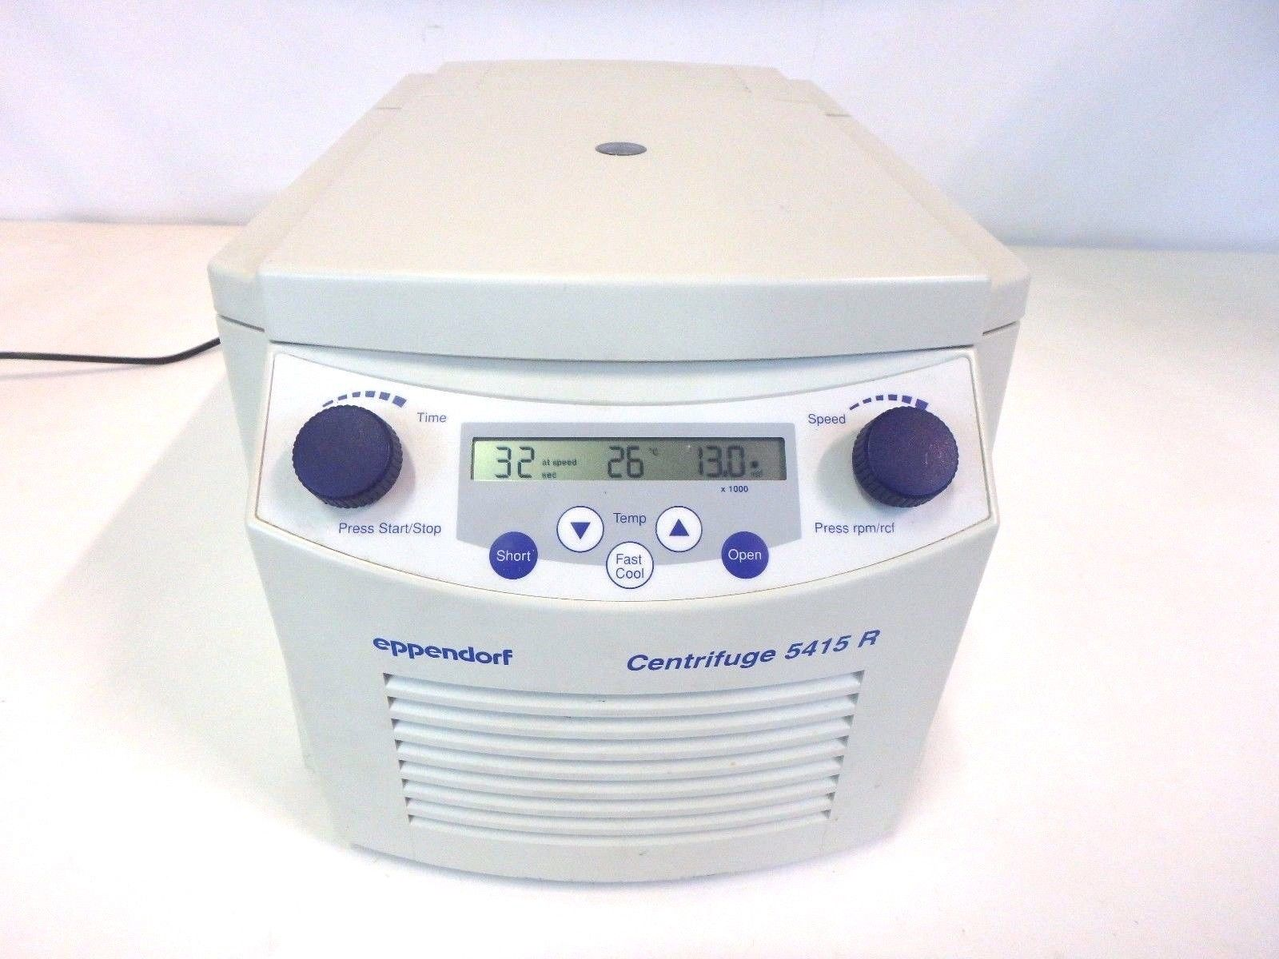
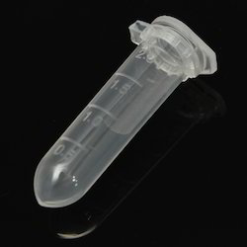
RNA isolation
Phenol + GITC+buffer+
Ammonium thiocyanate +
Sarkosyl+
Beta-МE+
8-hydroxyquinoline+
glycerine

Slide 4
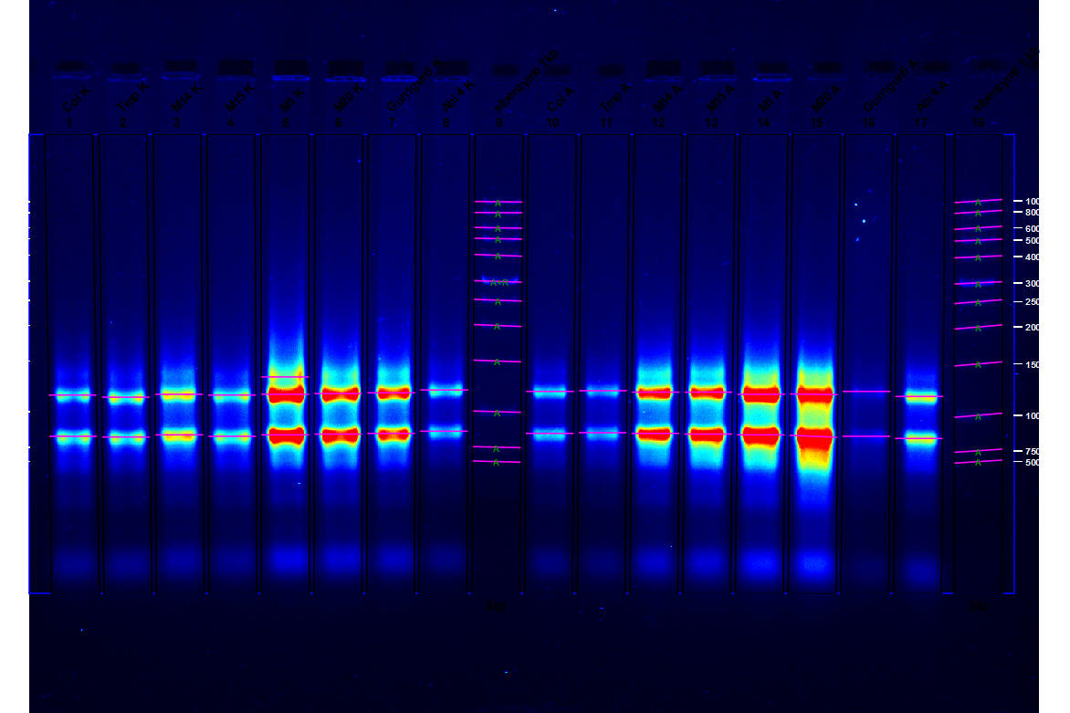
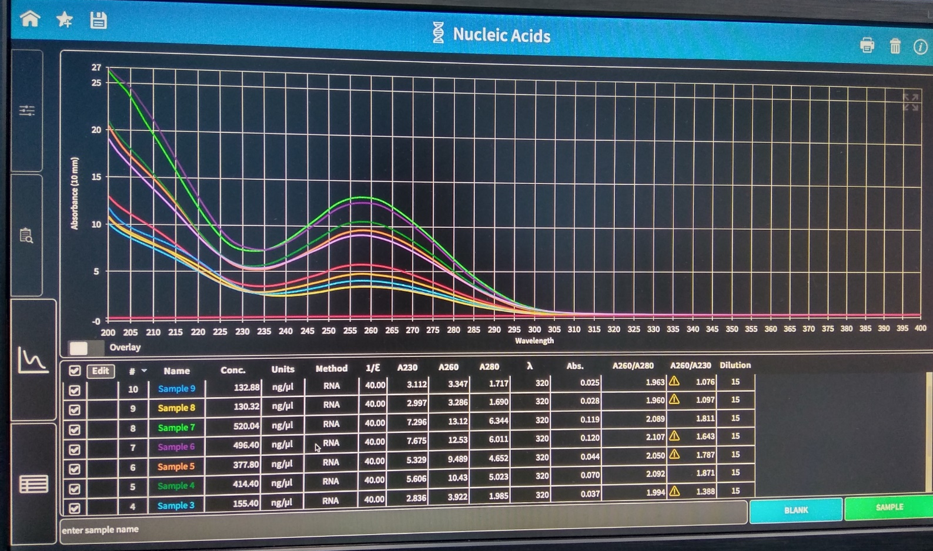
RNA quality control

Slide 5
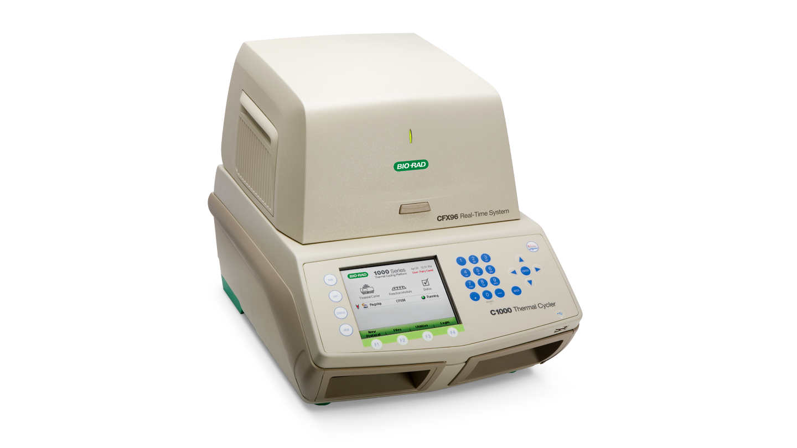
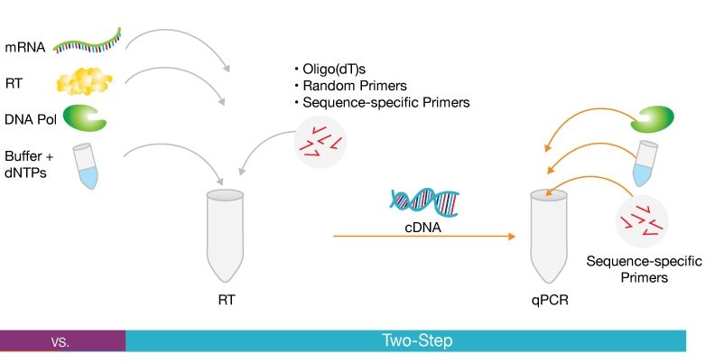
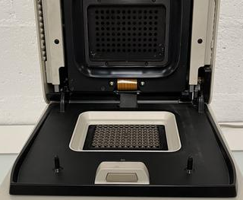
cDNA synthesis and PCR start

Slide 6
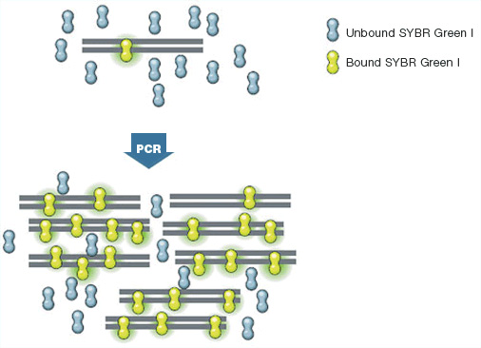
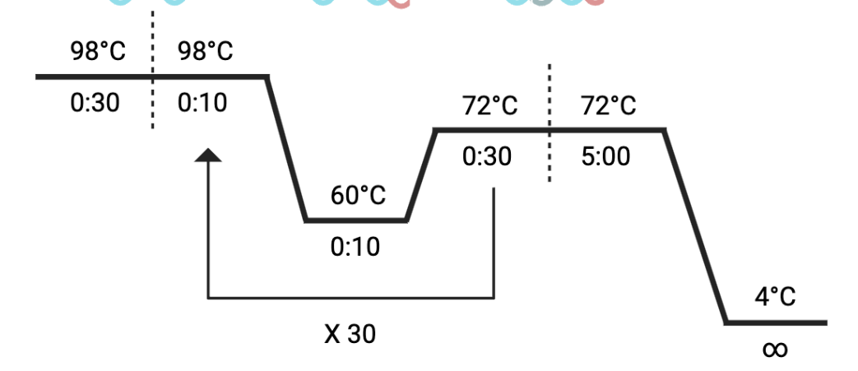
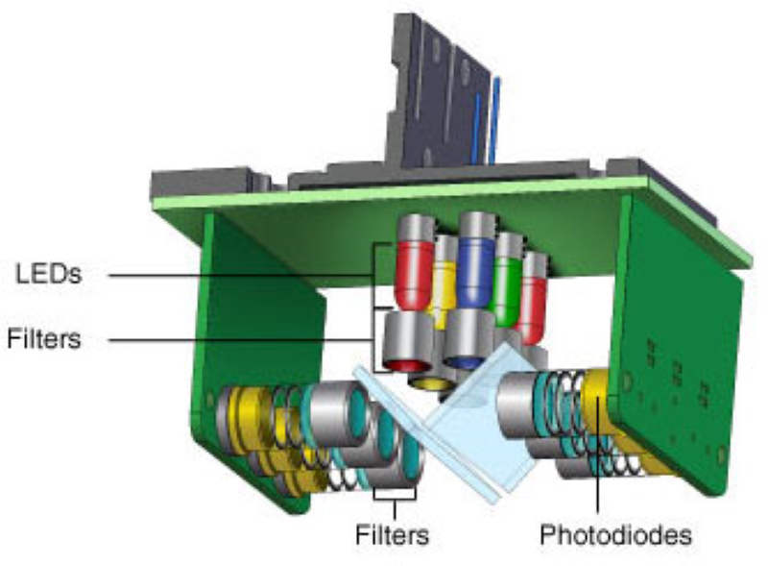
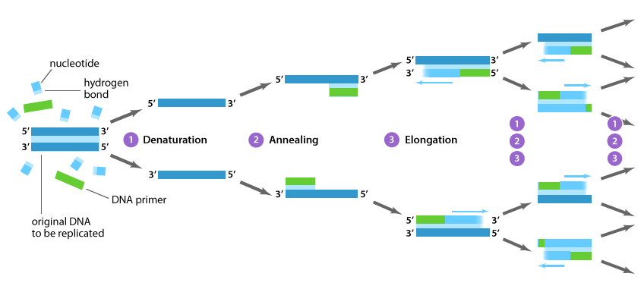
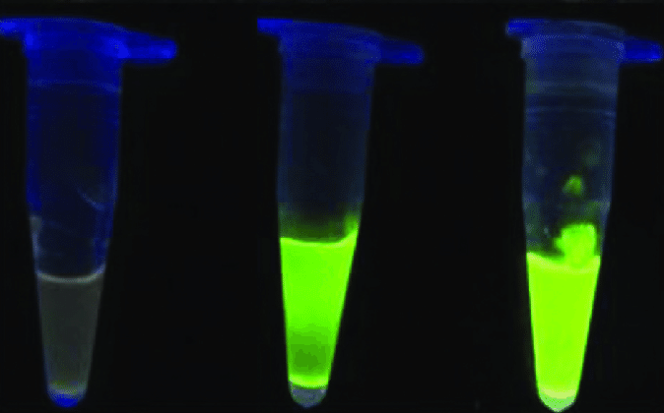
The PCR protocol

Slide 7
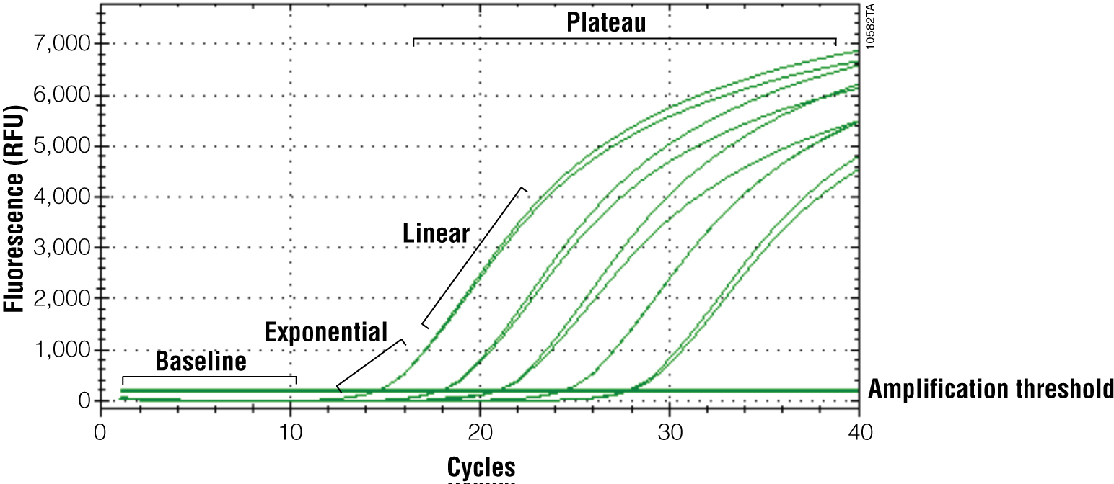
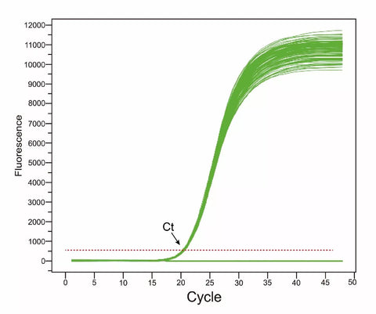
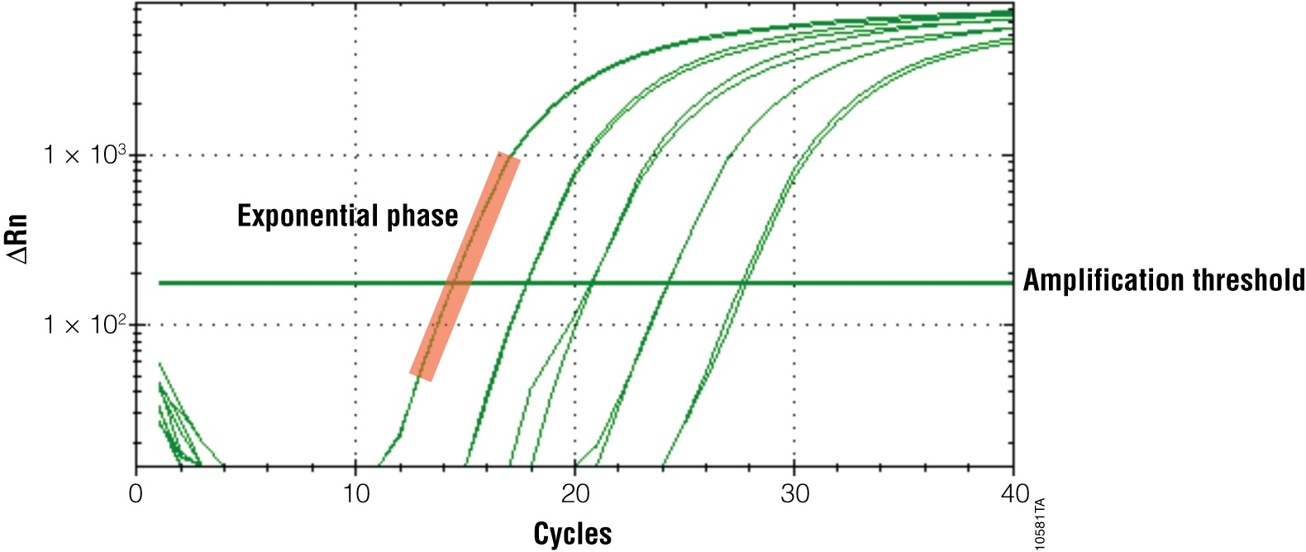
Fluorescence graphs and what is the Ct

Slide 8
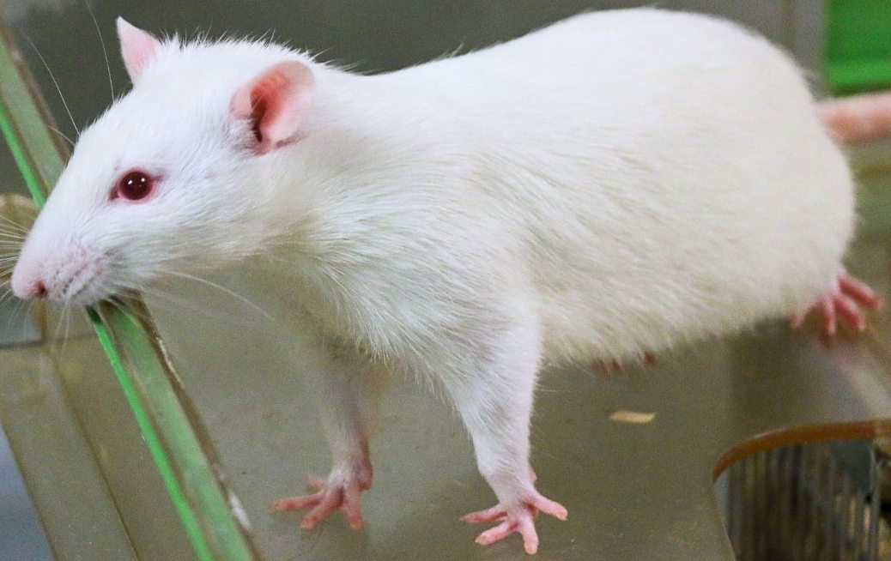
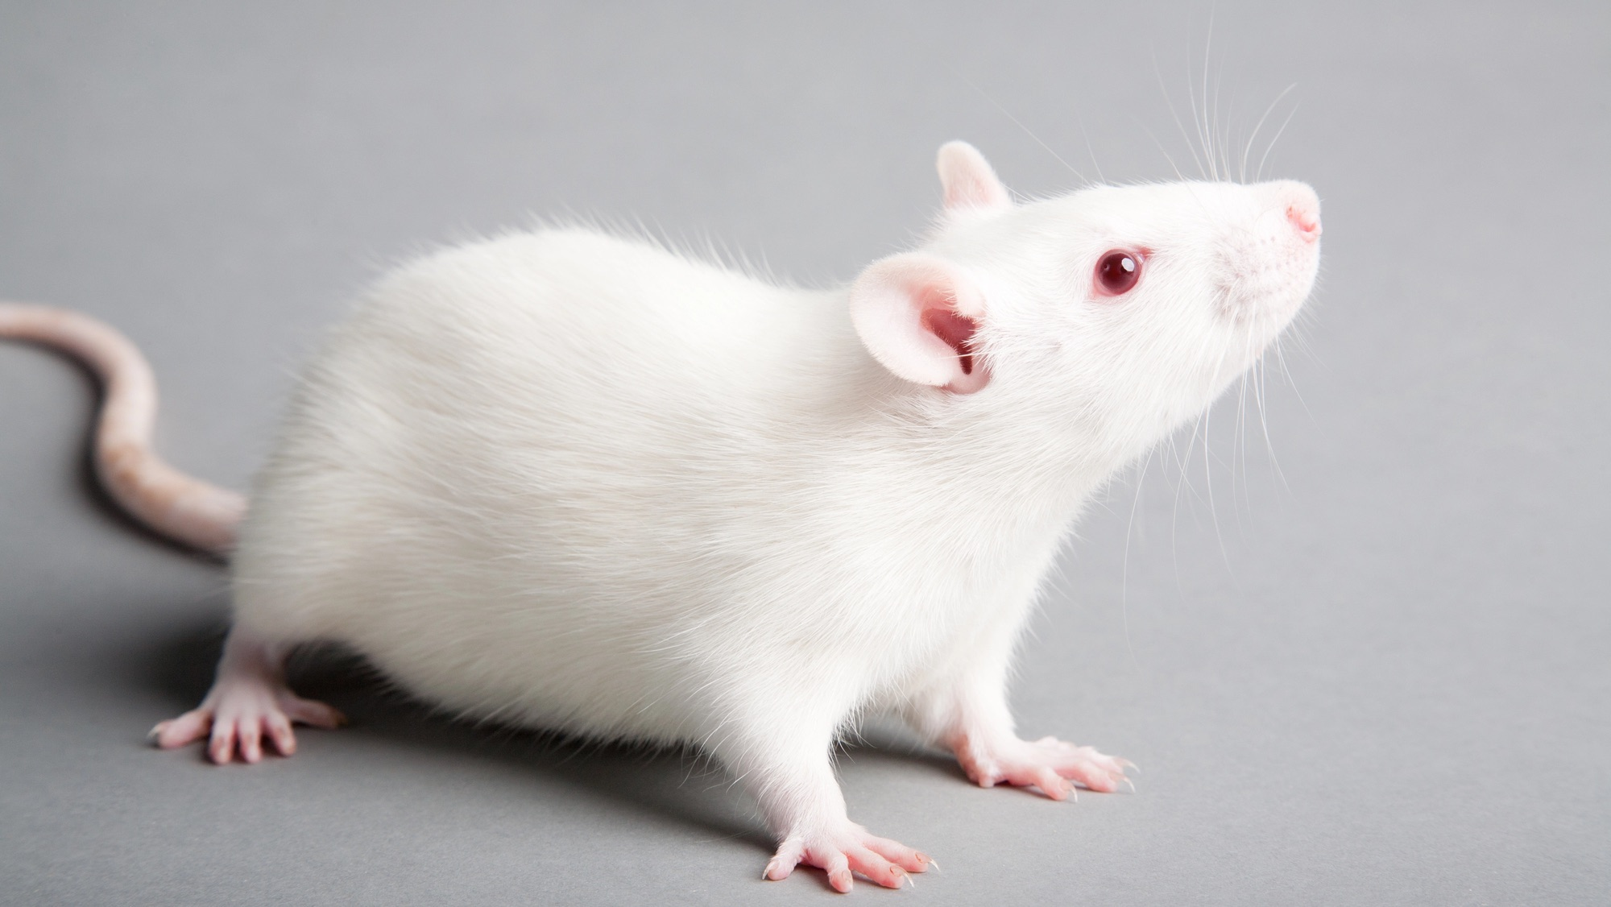


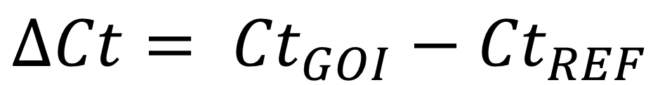
Ref – reference genes, expressed constitutievely (e.g. tubulin – a cytoskeleton microtubule protein)
GOI – Genes Of Interest, e.g. NTF
$FC=2^{−∆∆Ct}$
Rat taking rest
Rat learning the way through the labyrinth
$$∆Ct= {Ct}_{GOI}−{Ct}_{REF}$$
$$∆∆Ct= {∆Ct}_{TEST}−{∆Ct}_{WT}$$

